Slide 1
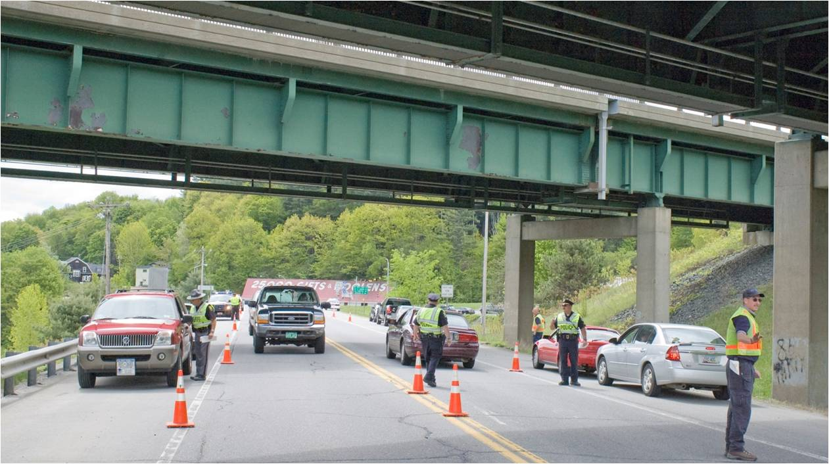
Notes:
Open for start of Program

Slide 2
Governor’s Highway Safety Program
2016 Law Enforcement Grants Webinar
Notes:
Introduction Bruce

Slide 3
Change in Venue
Department of Public Safety
Agency of Transportation
Notes:
Bruce- Discuss Changes in Venue

Slide 4
Change in Venue
Agency of Transportation and Department of Public Safety are excited and pleased to announce the transfer of the Governors Highway Safety Program (GHSP) to the
newly established
Highway Safety Office at AOT!

Slide 5
Change in Venue
As a result of AOT’s strategic restructuring, the opportunity to group Vermont’s highway safety initiatives under one roof,
building on what is already a shared vision for collaborative, coordinated planning among many
state and local partners.
Notes:
Bruce

Slide 6
Webinar Topics
Governor’s Highway Safety Program
Strategy and Best Practices
Grant programs
Application Process
Grant Agreements
Gathering & Reporting Data
Questions
Notes:
Bruce- Introduction to Staff at GHSP
Anne
Betsy
Allison
Coleen
Any one else there.
Coleen Take over……

Slide 7
Governor’s Highway Safety Program
Federal Grants are provided to the States to help implement programs to…
reduce major and overall crashes
Notes:
Coleen

Slide 8
Governor’s Highway Safety Program
Vermont Governor's Highway Safety Program (GHSP) awards federal highway safety grant funds to local, state and not-for-profit agencies for projects to improve highway safety and reduce deaths and serious injuries due to crashes.
Notes:
Coleen

Slide 9
Governor’s Highway Safety Program
The staff at GHSP …….
Reviews and Monitors the GHSP Grant Program
including:
Law Enforcement
Education
Drug Recognition Experts (DRE)
Traffic Records Systems
Provides Guidance and Oversight to State and Local Agencies.
Notes:
Coleen

Slide 10
Governor’s Highway Safety Program
The GHSP also works closely within a network of state and local agencies, non-profit organizations and private-sector partners to deliver quality traffic safety projects, services, and information across the state.
Notes:
Coleen

Slide 11
Governor’s Highway Safety Program
The GHSP grant program is structured on the federal fiscal year, October 1st - September 30th.
The following is an overview of the grant process, timeline, and other requirements related to grant program funding.
Notes:
Coleen

Slide 12
Strategy and Best Practices
A main component of fulfilling the Governor's Highway Safety Program’s mission involves empowering community and independent traffic safety organizations with guidance and support with project funding.
Notes:
Coleen

Slide 13
Strategic Highway Safety Plan Critical Emphasis Areas
Keeping Vehicles on the Roadway & Minimizing the Consequences of Leaving the Road
Improving Young Driver Safety
Improving the Design & Operation of Highway Intersections
Increasing Safety Belt Use
Reducing Impaired Driving
Curbing Speeding and Aggressive Driving
Keeping Drivers Alert
Notes:
Coleen-
Each state is required to have a comp. Safety Plan- Vermont's is formulated by the Vermont Highway Safety AllianceThese are the 7 critical areas.

Slide 14
Three Types of Grants for Law Enforcement
Occupant Protection Grants Program
2. DUI Enforcement Grants
3. Equipment Grants Program
Notes:
Coleen Introduce Betsy Again as Program Coordinator
Betsy Takes over

Slide 15
Occupant Protection Grants
This program provides incentive grants to encourage states to adopt and implement effective programs to reduce highway deaths and injuries resulting from individuals riding unrestrained or improperly restrained in motor vehicles. Areas for activities include:
Aggressive Driving
Speeding
Distracted Driving
Driving Unbelted
Child Restraint Misuse
Notes:
Betsy

Slide 16
DUI Enforcement Grants Program
Purpose
This program provided incentive grants to states that implemented effective programs to reduce traffic safety problems resulting from impaired driving.
To reduce alcohol and/or drug impaired driving and diminish its consequences in Vermont.
Notes:
Betsy

Slide 17
Enforcement Grants Program
In Vermont, speed, lack or misuse of safety belts, and alcohol are recognized as the top three issues in highway fatalities.
Notes:
Betsy

Slide 18
Radar and laser speed detection are examples of equipment awarded to departments participating in high–visibility campaigns such as (Click It or Ticket and Drive Sober or Get Pulled Over). *A new guidance will be issued regarding the ability to receive these grants in the very near future.
Equipment Grants
Notes:
Betsy

Slide 19
Source of Grant Funds
Federal Grants (NHTSA)
Other funding sources identified by sub-grantees (Match)
Notes:
Betsy
After introduce Allison

Slide 20
2016 Grant Application
AOT.GHSPGrantsLE@state.vt.us
Notes:
Allison: Open up application- Remind attendees to use form that is attached follow along on screen.

Slide 21
Application
Grant management requires governmental units to monitor sub-awards to assure compliance with applicable Federal requirements and cost principles
Notes:
Allison

Slide 22
Application Process
APPLYING FOR A HIGHWAY SAFETY GRANT
Who May Apply
State agencies
Political subdivisions of the state
(ex: counties, towns, villages or not-for-profit organizations that have oversight for highway safety or serve a population that is in need of highway safety program services)
The GHSP does not fund for-profit agencies.
Notes:
Allison

Slide 23
Application Process
Applications must be submitted electronically.
Notes:
Allison

Slide 24
Project Goals & Objectives
A goal is a benchmark
Established as an idea, to correct an identified problem
Long and Short-term
With Specific and Measureable Outcomes
Notes:
Allison

Slide 25
Application Components
Write a Problem Statement
Develop the Project Goals/Objectives/Activities
Develop Performance Measures
Create Timelines
Develop Your Action Plan
Evaluation Plan (how success will be measured: outcomes)
Resources Required: financial and community partners
Notes:
Allison

Slide 26
Application Process
The application is available to you electronically in fillable format. You may have downloaded it with the documents for this webinar. It is also available on our website: http://ghsp.vermont.gov
Follow the instructions and email all applications to:
AOT.GHSPGrantsLE@state.vt.us
Notes:
Coleen

Slide 27
Governor’s Highway Safety Program
Application Process
To be allowable, costs must be necessary, reasonable, allocable, and appropriate to the circumstance.
Federal funds must be used in accordance with the appropriate statute. Costs must be consistent with the authorizing statute and implementing
regulation, guidance and
must not be in violation of Federal, State and local laws.
Notes:
Coleen

Slide 28
Governor’s Highway Safety Program Application Process
GHSP's grant funding policy is based on governing statutes.
Grant regulations and directives, and supporting documents are contained in the Highway Safety Grant Management Manual:
http://www.nhtsa.gov/nhtsa/whatsup/TEA21/GrantMan/HTML/GrantFundPolicy_mkm_revJuly07.pdf
Notes:
Coleen

Slide 29
All costs charged to grants must be reasonable; allocable to the specific project; allowable under federal cost principles (if applicable), agency-specific policies, award-specific terms and conditions. See end of document for expanded discussion.
Governor’s Highway Safety Program Application Process
Notes:
Coleen

Slide 30
2015 Grant Application
Due April 9, 2015
by 3:00
Please submit electronically:
AOT.GHSPGrantsLE@state.vt.us
Notes:
Coleen: Talk about the importance this year of really good applications. Always have been competitive, but this year instead of seeing weak grants funded at lower levels, you will see weak application with no funding!
Introduce Anne

Slide 31
Grant Agreements
KEY Component
SPEND THE MONEY!
On
Data driven, focused activity designed to change behavior
Notes:
Anne

Slide 32
Gathering & Reporting Data
Web Crash - Canned - Ad Hoc Reports
Mandy White – 802-595-9341 mandy.white@state.vt.us
CAD/VIBRS
www.vthighwaysafety.com
www.nhtsa.dot.gov
Notes:
Anne

Slide 33
Crash Reduction Priorities
Restraint Use
Impaired Driving
Speeding and Aggressive Driving
Distracted Driving
Notes:
Anne

Slide 34
Review and Award
The Grant Allocation Advisory Group will:
Read every application before funding
Compare applications with GHSP priorities and verify applicants are addressing critical issues
Review and consider past performance, spending, reporting accuracy and timeliness
Make decision and notification
Notes:
Anne Back to Allison

Slide 35
Please Be Aware
Under MAP-21 the Federal Share for all funding sources is:
20 = 1
80 = 4
Match is therefore 25%
Notes:
Allison MAP-21 requirements.

Slide 36
Match Computation
25% Match Requirement for all Subgrants
Match can be met with cash or in-kind resources
Operating Costs (Paid for by the agencies own funds to support the project)
Indirect Costs (rate must be approved by Federal/State cognizant agency)
Third Party: personnel, goods, services – reasonable value must be used
Supporting Documentation with methodology for match is required
Notes:
Allison

Slide 37
Financial Monitoring and On-Site Review
GHSP uses a risk assessment for applicants to determine review and monitoring of subreciepient financials.
The on-site monitoring looks for internal controls and an adequate financial system.
The Monitoring team checks for compliance with regulations.
The team can require corrective actions if necessary.
Notes:
Allison

Slide 38
Getting Reimbursed
The grant provides you with funds to perform the services approved by GHSP.
You must submit the following to get reimbursed:
All requests for reimbursements should be submitted to your program coordinator with the original receipts (or agreements, contracts, or other documentation). Credit card statements are not considered original receipts.
Notes:
Allison

Slide 39
Getting Reimbursed
Back up documentation for reimbursement must be included with every Financial Report Form.
We can reimburse you for:
Activity as described in your application
Over time hours, mileage, in-state travel, dispatch hours if two or more officers are on duty, court hours if tickets are written on GHSP grants
Notes:
Allison

Slide 40
Reimbursement Forms
Financial Report Form (one each month, no report is necessary if there is no activity)
Supervisor’s Report
Officers Activity and Time Sheets (each report must be signed by supervisor)
Notes:
Allison

Slide 41
We Cannot Reimburse You For:
Training
Non Grant related assists/activity
Truck inspections/commercial vehicle enforcement
Rollover demos
Notes:
Allison

Slide 42
Monthly, Quarterly and Final Reports
Monthly Activity Reports and GHSP Financial Reports: (if no activity then reports are not required).
Quarterly Narrative Reports: (reports are required even if no activity).
Final Reports: Tell us what you did do compared with what you said you would do.
Reports can be electronically submitted
Notes:
Allison

Slide 43
Common Reporting Errors
Missing back up documentation
(ex: general ledger payroll report)
Incorrect mileage rate
Match Calculation: Federal Share vs. Non-Federal share
Missing signatures and dates
Unallowable activity
Missing Salary Sheets
Notes:
Allison

Slide 44
Grant Activity and Performance Management
All Awardees must follow the rules and guidelines for grant performance and reporting.
Anytime you have a question about this, please contact:
Betsy Ross at GHSP for programming, performance, changes in scope of work.
Notes:
Allison

Slide 45
Grant Reporting
GHSP will hold a separate webinar for the grant FINANCE REPORTING component portion of your grants around September of 2015.
Anyone that needs further assistance or would like to participate is encouraged to attend.
You will also be receiving your reporting forms electronically around that time as well.
Notes:
Allison

Slide 46
Help Is Always Available
Grant Questions: Betsy Ross 802-241-5511
GHSP Questions: Bruce Nyquist 802-828-2696
Data Questions: Mandy White 802-595-9341
LE Grant Coordinator
Betsy.Ross@state.vt.us
LELs:
Tom.Fields@state.vt.us (South)
John.Filipek@state.vt.us (North)
Notes:
Coleen

Slide 47
Questions and Comments
Notes:
Everyone

Slide 48
Thank You The Governors Highway Safety Program
Notes:
Bruce

